Slide 1

Lecture 38
DATA 8
Spring 2020
Conclusion

Slide 2
Announcements

Slide 3
Data Science

Slide 4
Why Data Science
Unprecedented access to data means that we can make new discoveries and more informed decisions
Computation is a powerful ally in data processing, visualization, prediction, and statistical inference
People can agree on evidence and measurement
Data and computation are everywhere: understanding and interpreting are more important than ever

Slide 5
Limitations of Data Science
Evidence and measurements are critical ingredients for good decision-making
...but they’re not enough by themselves!
Data science is a powerful complement to qualitative analysis
...but it’s not a replacement!

Slide 6
How to Analyze Data
Begin with a question from some domain, make reasonable assumptions about the data and a choice of methods.
Visualize, then quantify!
Perhaps the most important part: Interpretation of the results in the language of the domain, without statistical jargon.

Slide 7
How Not to Analyze Data
Begin with a question from some domain, make reasonable assumptions about the data and a choice of methods.
Visualize, then quantify!
Perhaps the most important part: Interpretation of the results in the language of the domain, without statistical jargon.

Slide 8
How to Analyze Data after Data 8
Begin with a question from some domain, make reasonable assumptions about the data and a choice of methods.
Visualize, then quantify! Do both using computation.
Perhaps the most important part: Interpretation of the results in the language of the domain, without statistical jargon.

Slide 9
The Design of Data 8
Table manipulation using Python
Working with whole distributions, not just means
Decisions based on sampling: assessing models
Estimation based on resampling
Understanding sampling variability
Prediction

Slide 10
Using Data Science to Understand COVID-19

Slide 11
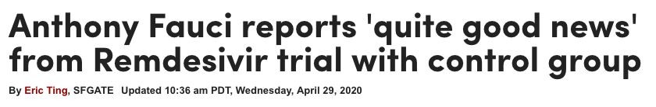
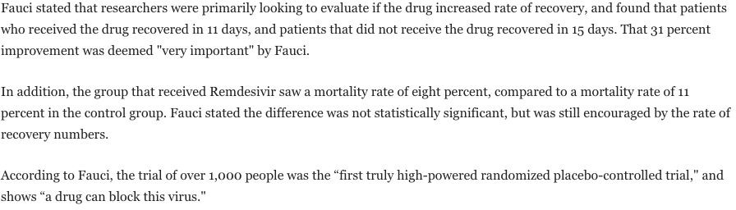
COVID-19: Remdesivir
https://www.sfgate.com/coronavirus/article/Remdesivir-control-group-trial-results-Fauci-NIAID-15234422.php

Slide 12
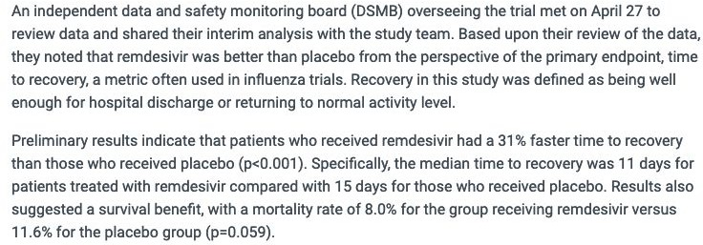
COVID-19: Remdesivir
https://www.niaid.nih.gov/news-events/nih-clinical-trial-shows-remdesivir-accelerates-recovery-advanced-covid-19

Slide 13
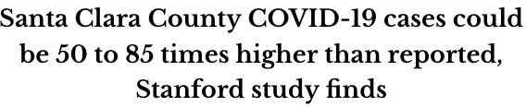
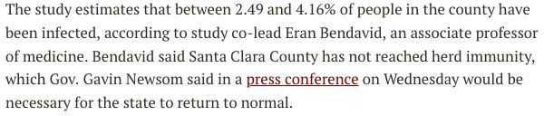
COVID-19: Santa Clara County
https://www.stanforddaily.com/2020/04/17/santa-clara-county-covid-19-cases-could-be-50-to-85-times-higher-than-reported-stanford-study-finds/

Slide 14
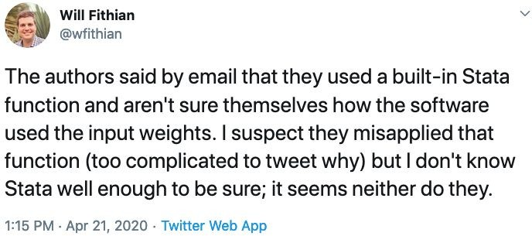
COVID-19: Santa Clara County

Slide 15
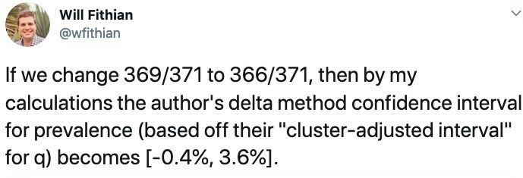
COVID-19: Santa Clara County

Slide 16
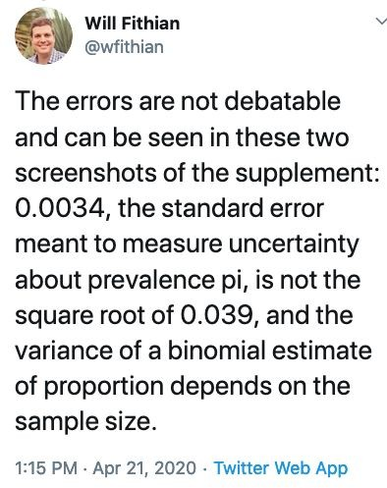
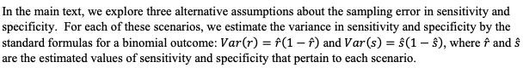
COVID-19: Santa Clara County
Variance of a sample proportion

Slide 17
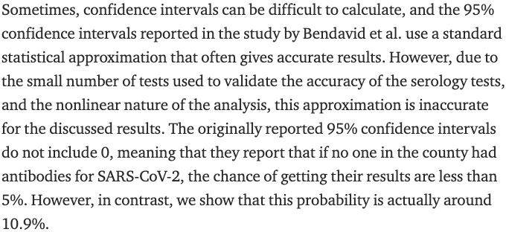
COVID-19: Santa Clara County
https://medium.com/@steve.yadlowsky/large-variability-in-serology-estimates-of-prevalence-of-sars-cov-2-28151ae4709e

Slide 18
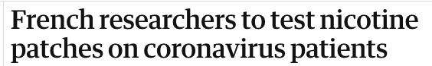
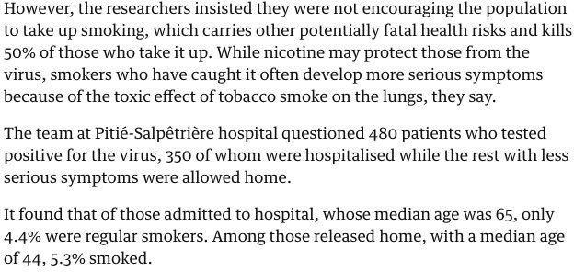
COVID-19: Nicotine and causality
https://www.theguardian.com/world/2020/apr/22/french-study-suggests-smokers-at-lower-risk-of-getting-coronavirus

Slide 19
A Request

Slide 20
Please fill out the course evaluations!

Slide 21
Course Overview Slides

Slide 22
What's Next?

Slide 23
Guest Presentations

Slide 24



Spring 2020
Student Opportunities
data.berkeley.edu

Slide 25

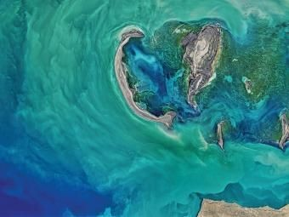
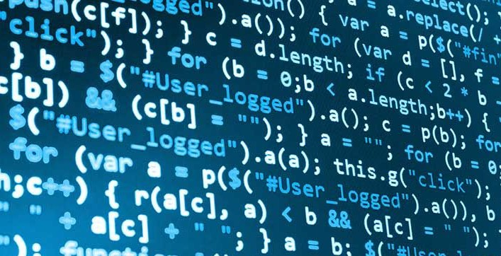
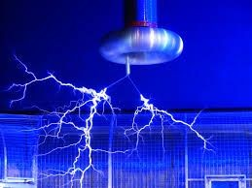

Fall 2020 Connectors
EPS 88
PyEarth: A Python Introduction to Earth Science
STAT 88
Prob and Stats in Data Science
UGBA 88
Data and Decision
COMPSCI 88
Computational Structures
PHYSICS 88
Data Science Applications in Physics
DATA 88-3
Economic Models
25

Slide 26
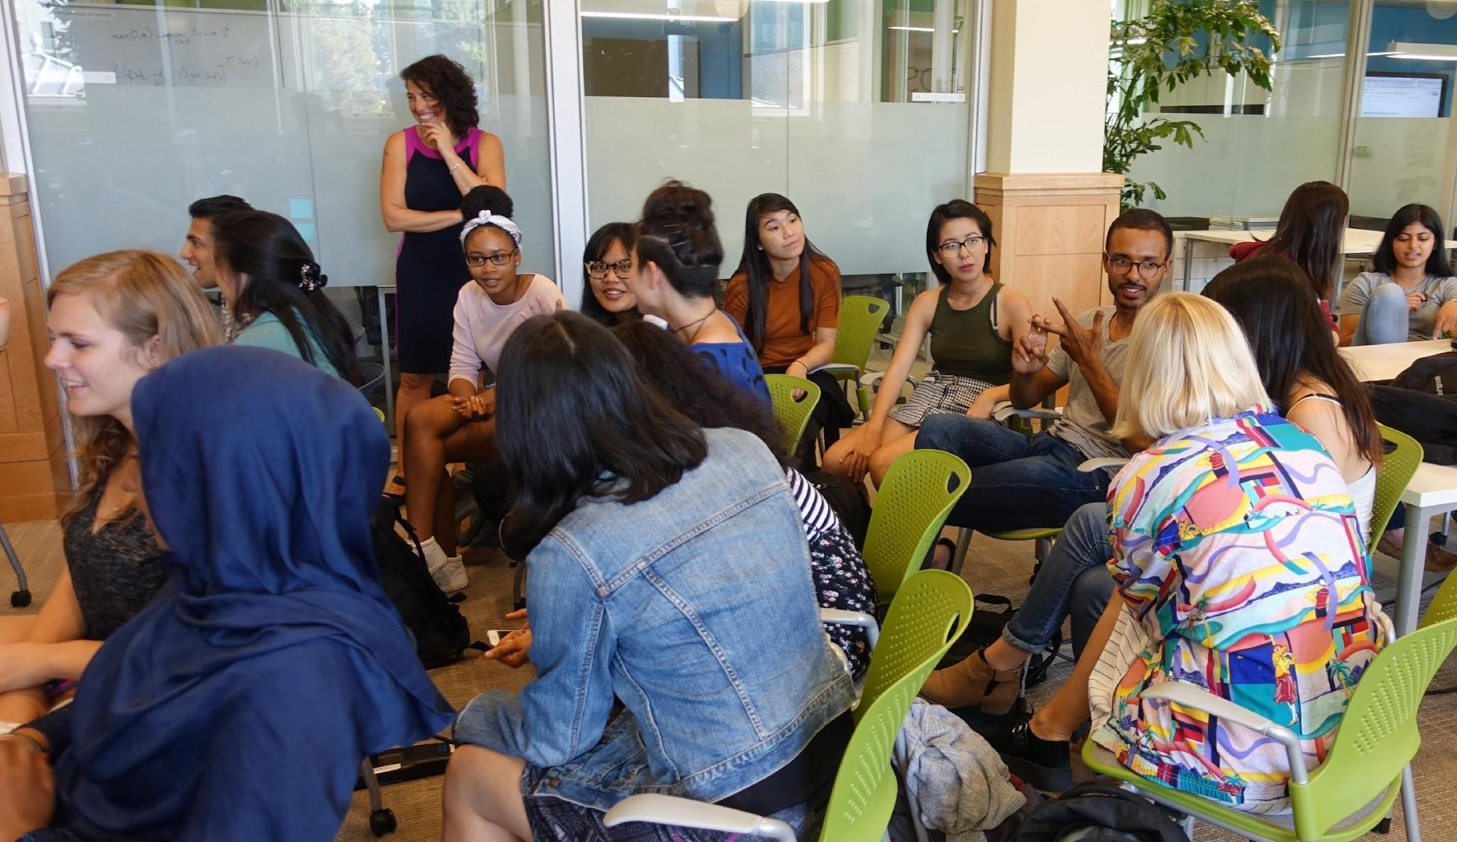

Data Scholars
Data Scholars serves these
For students who are
Low income
First generation college
Historically underrepresented
populations to support diversity in the Data Science student community all the way through.
Foundations Concurrent to Data 8
Pathways Further technical
skill & career development
Discovery Support for research
experiences
26

Slide 27


DSEP Student Teams
Hone your skills as an educator and data scientist by working with the Data Science Education Program
Help fellow undergrads with data research, academic work, and data science technology.
Help deliver Data 8 instruction via online cloud based instruction
Create a national community of practice for institutions to work with and learn from each other.
Online Learning
External Pedagogy
Peer Consulting

Slide 28
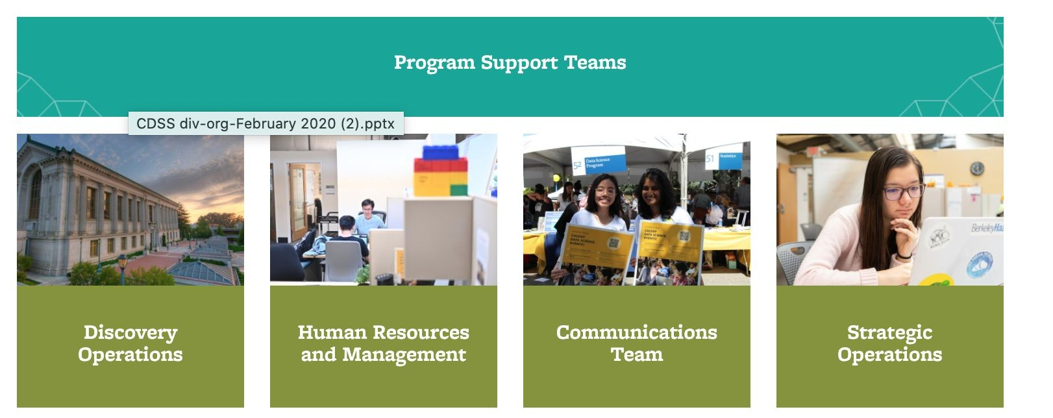
DSEP Student Teams
Hone your skills as an educator and data scientist by working with the Data Science Education Program

Slide 29

DSEP Student Teams
Hone your skills as an educator and data scientist by working with the Data Science Education Program
Integrate critical thinking about ethical issues in relation to technology into the Berkeley data science program and community.
Help instructors of Data Science Connector courses deliver and teach material.
Create curriculum materials for Connectors,
Data-Enabled Courses, or short explorations into DS (modules).
Connector Assistants
Human Context and Ethics
Modules

Slide 30











Discovery Student Researchers
Be a student researcher in a program that connects students with hands-on data science research- non-proﬁts, start-ups, institutions, etc. Students from underrepresented minority groups and ﬁrst-time researchers receive priority.
https://data.berkeley.edu/research/discovery-program-home
30

Slide 31
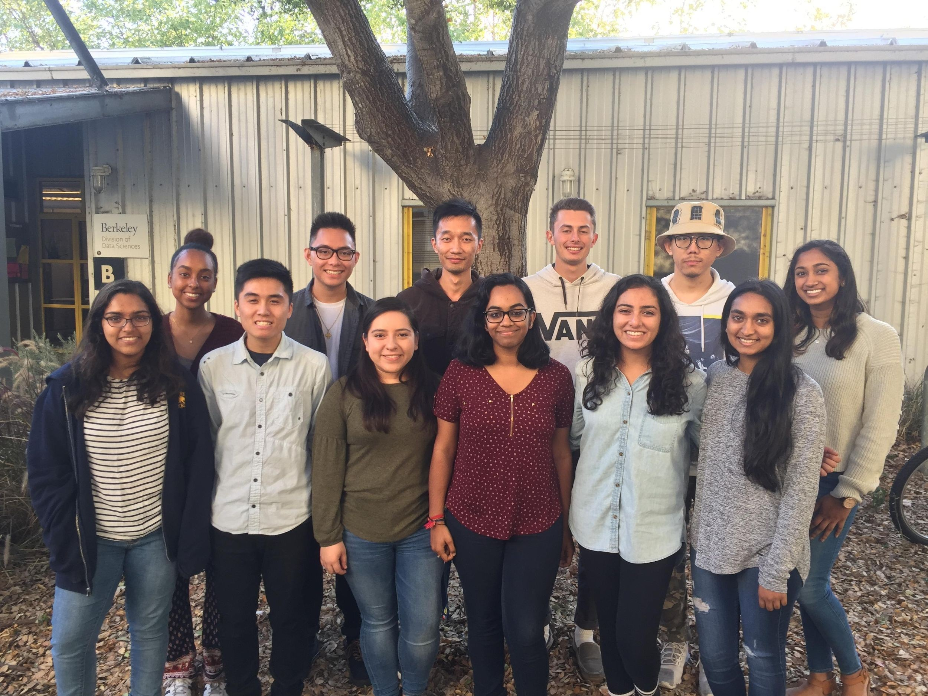
Data Science Peer Advising
Peer Advisors share their diverse knowledge of and experiences with:
major courses
different data science major domain emphases
extracurriculars and student groups on campus
research opportunities
and various campus resources.
Peer Advisors work closely with the Data Science Advising Team and gain exposure to the ins-and-outs of a new and increasingly popular interdisciplinary major.

Slide 32
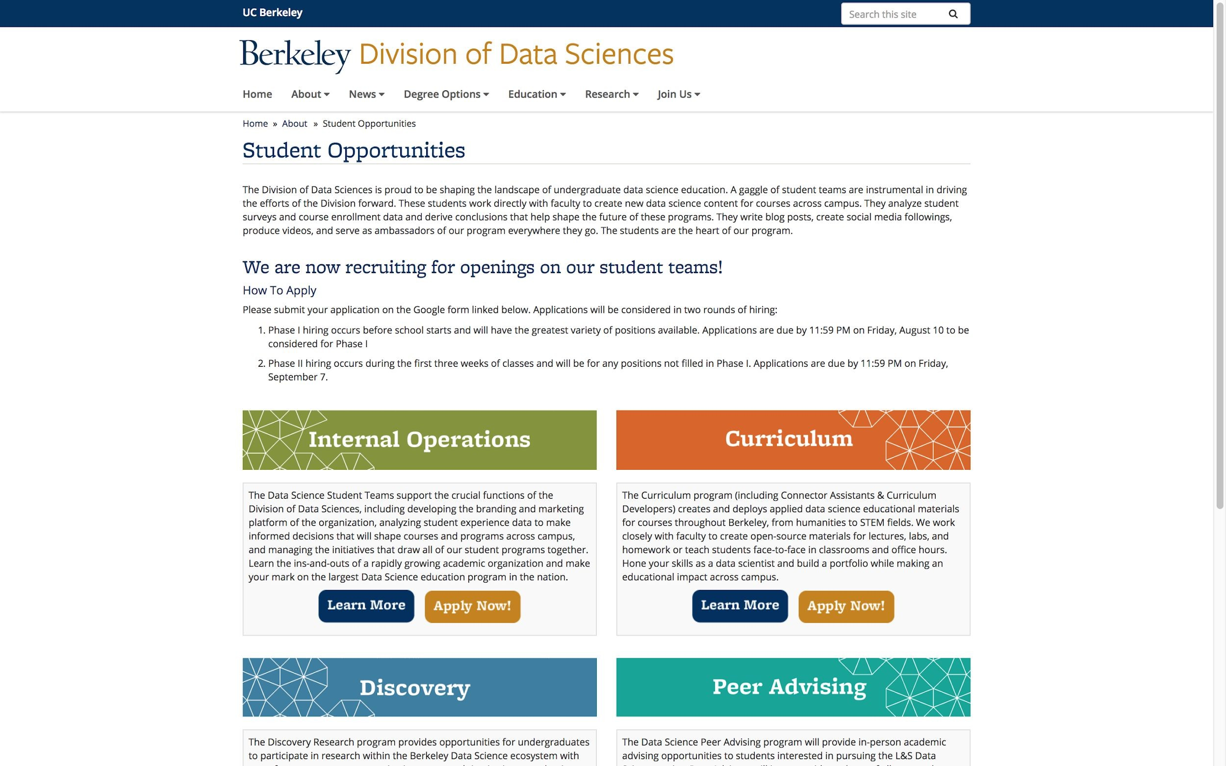
How to Apply
For more information, check out our website at
Applications will re-open in July
https://data.berkeley.edu/academics/resources/student-opportunitie s

Slide 33
The Team

Slide 34
Staff
GSIs
Tutors
Lab Assistants

Slide 35
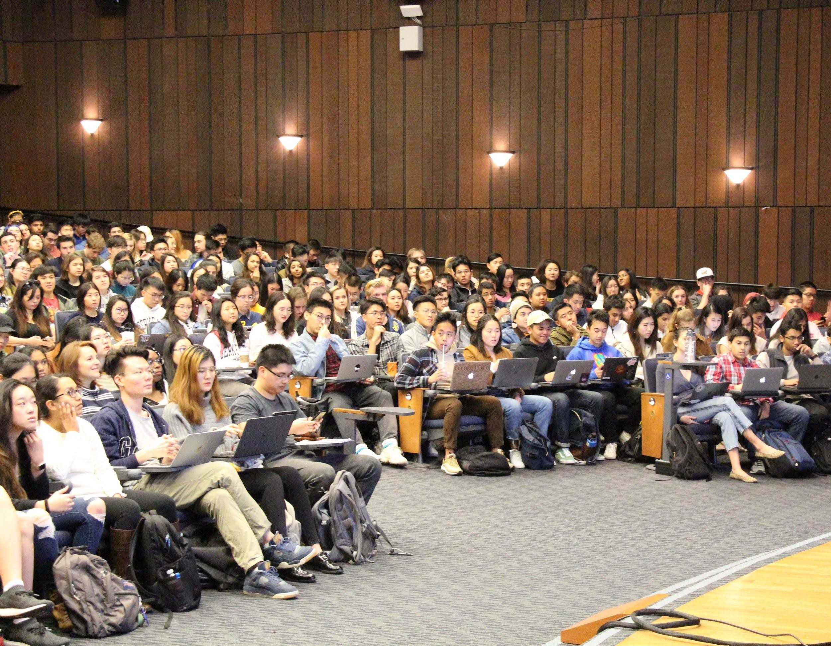

Thank you!

